Slide 1
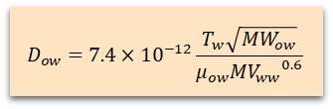





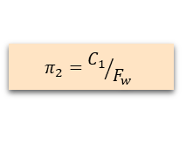





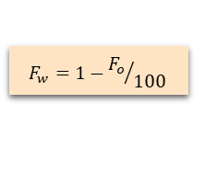



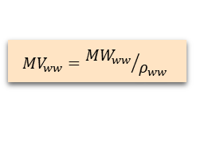




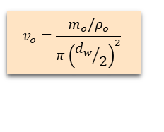
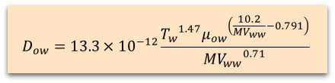
Matzain (Single Phase) Sub routine
Define $P_{io}, T_{oi}$
Get $ρ_{o}$
from TAB table
Define $P_{io}, T_{w}$
$$v_{o}=\frac{m_{o}/ρ_{o}}{π{\left({d_{w}}/2\right)}^{2}}$$
Get $ρ_{ow},μ_{ow}$ from TAB table
Get $ρ_{ww},{MW}_{ww},{MW}_{ow}$
from WAX table
Define $m_{o}$
Define $d_{i}, d_{w}$
$$δ_{d}=\frac{d_{i}−d_{w}}{2}$$
$$N_{SR}=\frac{ρ_{ow}v_{o}δ_{d}}{μ_{ow}}$$
$${Re}_{ow}=\frac{ρ_{ow}v_{o}d_{w}}{μ_{ow}}$$
$$F_{o}=100\left(1−\frac{{{Re}_{ow}}^{0.15}}{8}\right)$$
$$π_{1}=C_{2}{N_{SR}}^{C3}$$
Define $C_{1},C_{2}, C_{3}$
$$π_{2}={C_{1}}/{F_{w}}$$
$$F_{w}=1−{F_{o}}/{100}$$
$${MV}_{ww}={{MW}_{ww}}/{ρ_{ww}}$$
Define $\frac{dC}{dT},\frac{dT}{dr}$
$$\frac{dδ}{dt}=\frac{π_{1}}{1+π_{2}}D_{ow}\frac{dC}{dT}\frac{dT}{dr}$$
Calculate $D_{ow}$
Wilke-Chang
$$D_{ow}=7.4×{10}^{−12}\frac{T_{w}\sqrt{{MW}_{ow}}}{μ_{ow}{{MV}_{ww}}^{0.6}}$$
$$δ=δ_{t−1}+\frac{dδ}{dt}dt$$
$$D_{ow}=13.3×{10}^{−12}\frac{{T_{w}}^{1.47}{μ_{ow}}^{\left(\frac{10.2}{{MV}_{ww}}−0.791\right)}}{{{MV}_{ww}}^{0.71}}$$
Hayduk-Minhass
End of time iteration
Internal

Slide 2












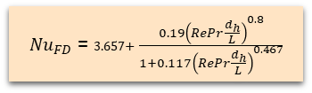
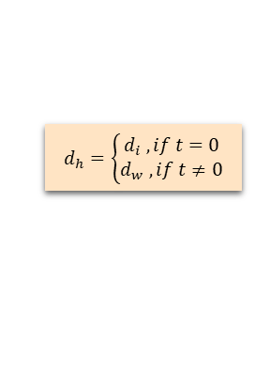

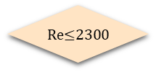
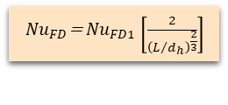





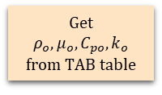









$α_{w}$ or $α_{c}$ calculator
$α_{w,g}$ calculator
$α_{c}$ calculator
Define $d_{i}, d_{w}$
$d_{h}=\left\{\begin{aligned}d_{i} , if t=0 \\ d_{w} , if t≠0\end{aligned}\right.$
Define L
$$d_{h}=d_{o}$$
Define $P_{io}, T_{o}$
$${Re}_{o}=\frac{ρ_{o}v_{o}d_{h}}{μ_{o}}$$
$${Re}_{c}=\frac{ρ_{c}v_{c}d_{h}}{μ_{c}}$$
Define $P_{io}, T_{c}$
$$L/d_{h}$$
Get
$$ρ_{o},μ_{o},C_{po},k_{o}$$
from TAB table
$${Pr}_{o}=\frac{μ_{o}C_{po}}{k_{o}}$$
$${Pr}_{c}=\frac{μ_{c}C_{pc}}{k_{c}}$$
Get
$$ρ_{o},μ_{o},C_{pc},k_{c}$$
from TAB table
Get $μ_{o},μ_{ow}$ from TAB table
${Nu}_{D}$= ${Nu}_{FD}{\left(\frac{μ_{o}}{μ_{ow}}\right)}^{0.11}$
Calculate
${Nu}_{FD}$
$${Nu}_{D}={Nu}_{FD}$$
$$α_{w,g}=\frac{{Nu}_{D}}{d_{h}}k_{o}$$
$$α_{c}=\frac{{Nu}_{D}}{d_{h}}k_{c}$$
$$f={(0.79\ln{Re}−1.64)}^{−2}$$
No
$\text{Re}\text{≤2300}$
Yes
$$L_{e}=0.06Re×d_{h}$$
${Nu}_{FD}$=1.86 ${\left(\frac{RePr}{L/d_{h}}\right)}^{\frac{1}{3}}$
No
${Nu}_{FD1}$= $\frac{\left(\frac{f}{8}\right)\left(Re−100\right)Pr}{1+12.7{\left(\frac{f}{8}\right)}^{0.5}\left({Pr}^{\frac{2}{3}}−1\right)}$
$$\frac{\text{L}}{{\text{d}}_{\text{h}}}\text{≥}\text{60}$$
Yes
$$L≤L_{e}$$
No
$$\text{Pr}\text{≥5}$$
Yes
$${Nu}_{FD}={Nu}_{FD1}$$
No
Yes
${Nu}_{FD}$= ${Nu}_{FD1}\left[\frac{2}{{\left(L/{d_{h}}\right)}^{\frac{2}{3}}}\right]$
${Nu}_{FD}$= 3.657+ $\frac{0.19{\left(RePr\frac{d_{h}}{L}\right)}^{0.8}}{1+0.117{\left(RePr\frac{d_{h}}{L}\right)}^{0.467}}$
${Nu}_{FD}$= 3.66+ $\frac{0.0668RePr\frac{d_{h}}{L}}{1+0.04{\left(RePr\frac{d_{h}}{L}\right)}^{\frac{2}{3}}}$
Internal

